Slide 1
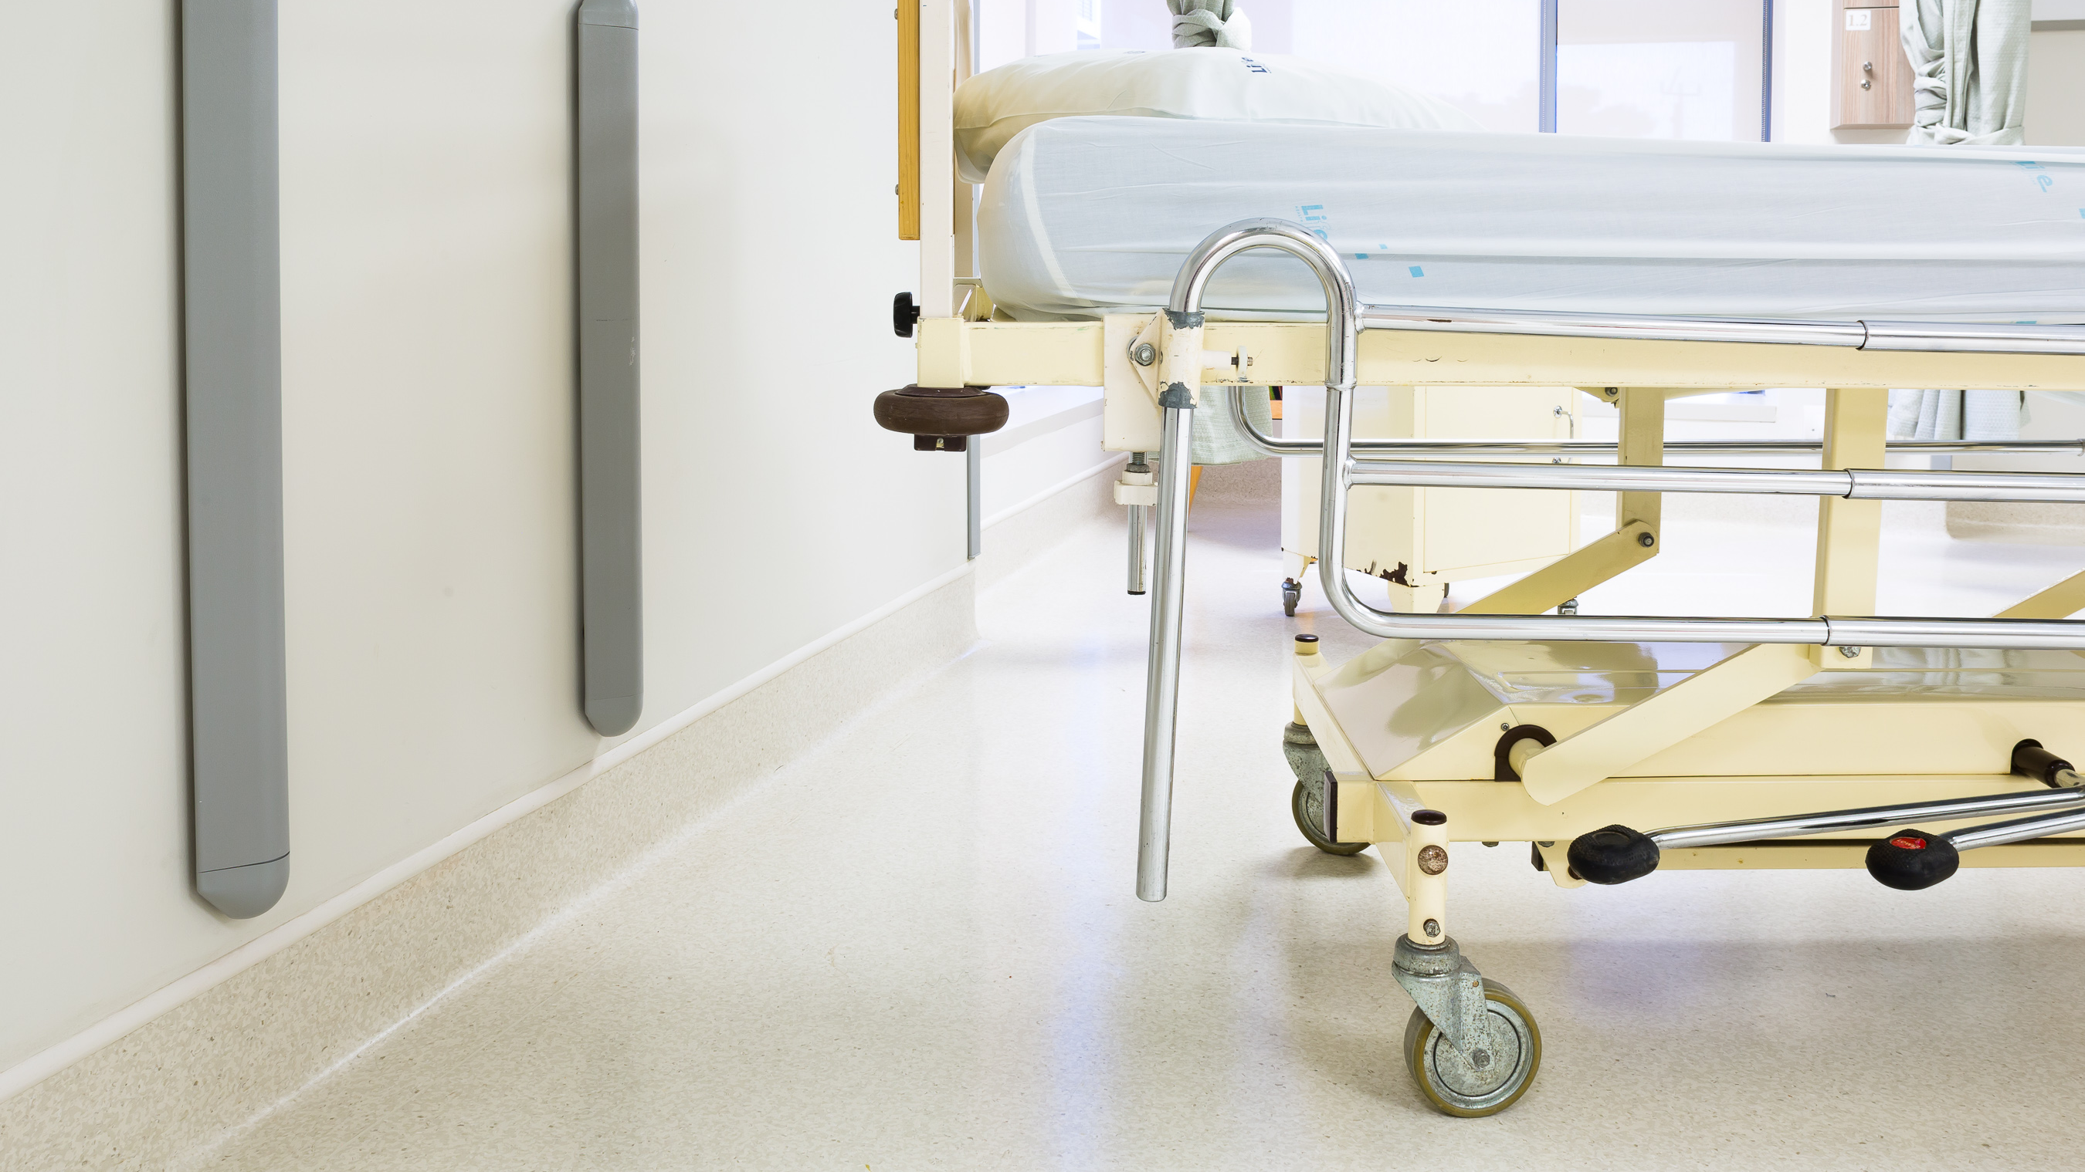
WALL PROTECTION

Slide 2
Notes:
Polyflor SA is a South African company with a heritage rich in flooring that dates back to the 1950s. Strong family ties to Polyflor UK. We specialise in vinyl flooring and building protection solutions. We have a national presence.
Superior products are a given. The intricate nuances involved in getting it done right is the difference. It's our commitment to you.
In our endeavour to achieve an excellent installation and solutions to ongoing challenges we have engaged with the suppliers of subfloor products.

Slide 3
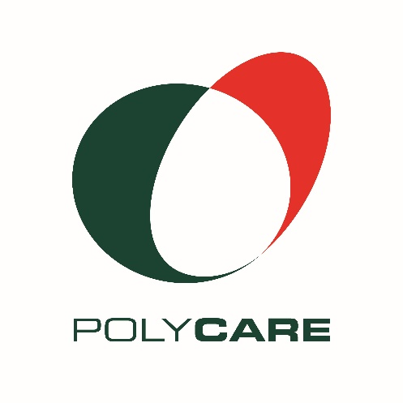
Attentiveness
Responsibility
Competence
Responsiveness
Respect
Collaboration
Notes:
PolyCare is part of our DNA. Superior product is a given. The intricate nuances involved in getting it done right is the difference. It's our commitment to you.
Our PolyCare philosophy is ingrained in our DNA and guides our every decision, action and recommendation. It is the fundamental philosophy we live by.
Years of experience have skilled us to help you ensure a successful outcome and we provide you with an end-to-end specialised consultative service, guaranteed to ensure the best outcome.
We work with you to understand your design and functional needs, and ensure we provide you with the best product at the best price. We see you through the journey, from start to finish, providing constant support and technical advice required along the way, helping to mitigate your risks.

Slide 4
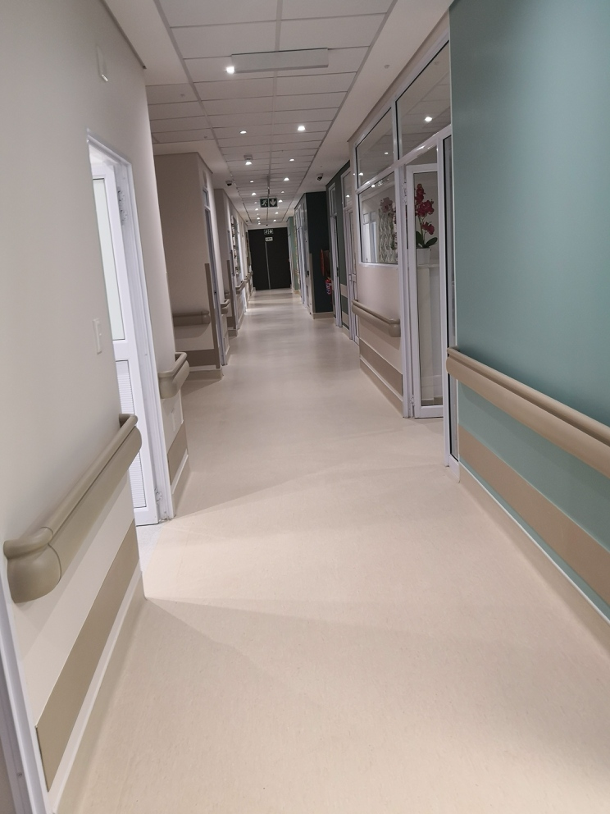
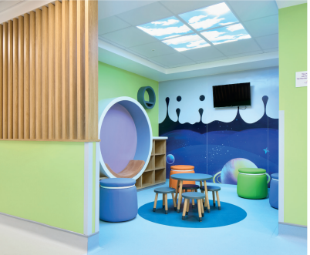
Many studies have shown that people living with dementia can be influenced by use of colour in the hospitals and healthcare facilities they are in. Our protective products can be used to bring colour into these environments whilst also assisting with mobility.
Why Gradus Wall Protection?
Reduce maintenance costs
Resistance to impact damage
Improve the overall appearance of an interior
The hygienic wall cladding system offers excellent surface protection
Easy to clean surface
Wayfinding
Chemical Resistance
Bacterial Resistance
Fungal Resistance
Impact Resistance
Notes:
- Most Effective Cheaper alternative to continuous plastering and painting of walls
- Absorbs and dissipate impact from wheeled traffic –and
- Modern designed profiles contribute to the interior look
Easy to clean
Wayfinding

Slide 5
SELECTING THE RIGHT PRODUCT
ZONES: Reception/Entrances, Wards, Corridors, Service Areas, Kitchens, Accommodation
COLOUR THEMES: Gradus wall protection products are available in an extensive range of colour, material, and design options.
PRODUCT DESIGN: A full range of product options designed to provide functional and aesthetic solutions for working environments.

Slide 6
WALL PROTECTION
Notes:
- Overview of recommended areas to put up wall protection to maximise cost efficiency
- Polyflor Support to identify areas and recommend appropriate products

Slide 7
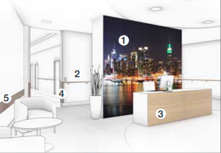
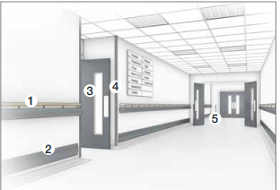
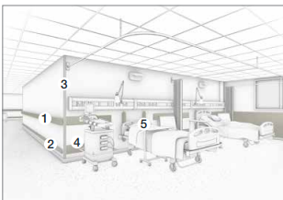
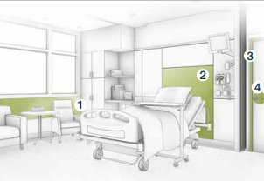
ZONES IN HEALTHCARE
Example: Reception Area
Waiting areas are often subject to scuffs and scrapes from
tables, chairs, and other movable objects. Corners and edges
are also vulnerable to damage from deliveries and other wheeled
traffic entering the building.
Example: Hospital Corridor 4
Pedestrian foot traffic including patients, visitors, and staff;
And wheeled traffic including wheelchairs and other mobility
Assistance devices, beds, trolleys, laundry carts, and mobile
equipment are all potential causes of damage in hospital
corridors.
Example: Ward
Hospital patients are regularly wheeled in and out of wards in
wheelchairs and mobile beds which risk gouging wall surfaces if
a collision were to occur. Other typical causes of damage include
mobile medical equipment and service trolleys.

Slide 8
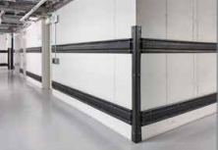
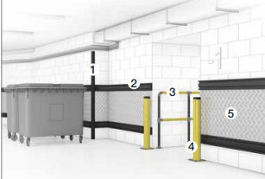
RUBBER IN SERVICE AREAS
Example: Service Area
* Wheeled traffic such as industrial bins and carts are capable of
* causing significant damage when accidental collisions occur.
* Motorized traffic including delivery vans and motorized trolleys are also potential hazards in service areas
Rubber
• Designed to deflect impact, protecting both wheeled traffic and building interiors against impact damage
Reflective
• Highly visible to alert vehicle users and protect both vehicles and buildings from impact damage

Slide 9
LRV AND WAYFINDING
Notes:
Colours is used very successfully in a healthcare environment not only has an impact on healing but serves as a great way finder. With the array of PVC wall protection colours this can be achieved.
Not many other options of wall protection allow beautiful use of colour.

Slide 10
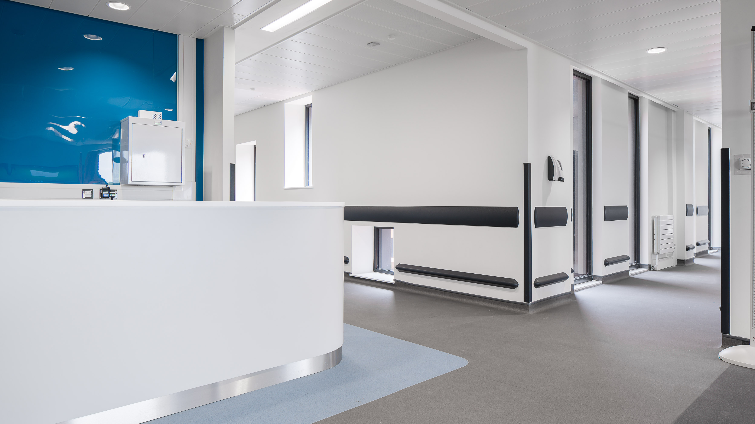
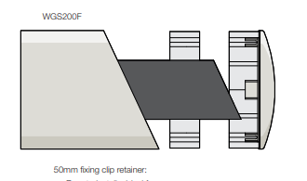
WALL GUARDS
Notes:
Wall protection products are designed to protect interior building surfaces from damage caused by the general flow of wheeled and pedestrian traffic.
So Polyflor is a distributor Gradus wall protection systems….Gradus manufacturing for nearly two decades. Extensive range
2017 saw Gradus launch a new and exciting range of wall protection profiles with modernised look but still effective

Slide 11
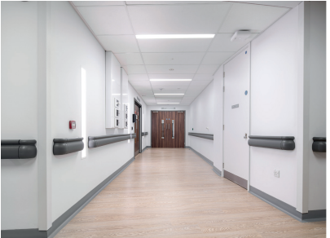
HANDRAILS
One type of wall protection that should
stand out is handrails.
Designed to provide pedestrians with
guidance and support, while also offering a degree of surface protection from wheeled traffic, handrails and
combination rails should have a light
reflective value (LRV) of at least 30
points’ difference to the surface that
surrounds them, as this ensures ease of
recognition.

Slide 12
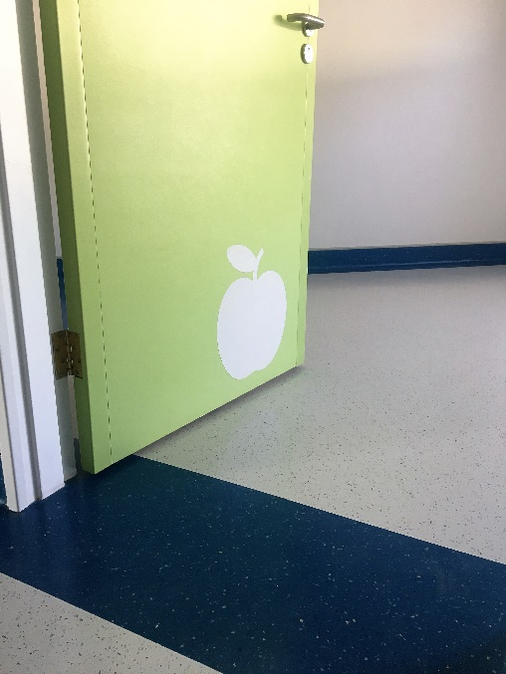
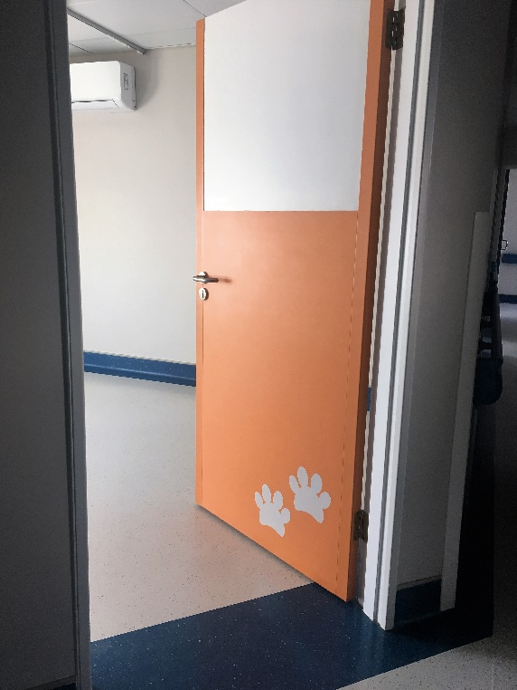
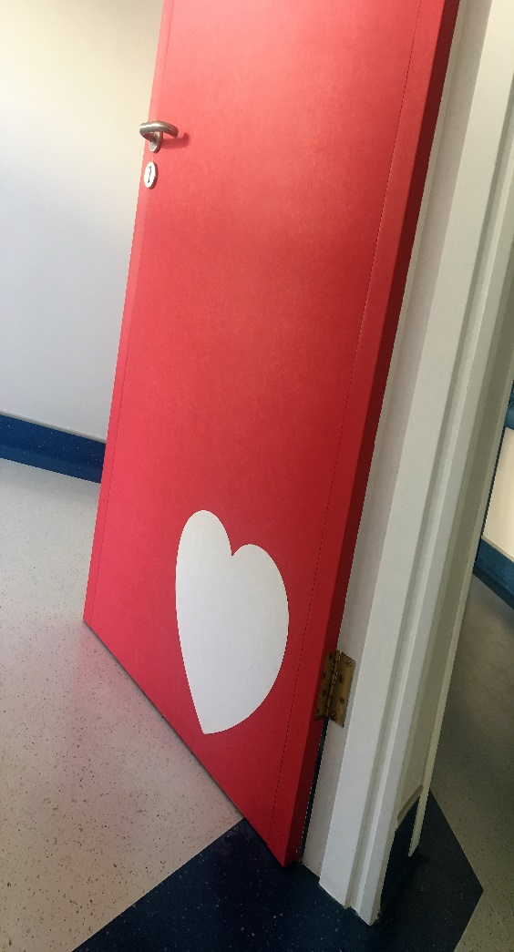
Notes:
SureProtect Endure – Kick Plates
Door cladding with superimposed images to create seamless look and still functional too
Fantastic tool for wayfinding – many patients who had trouble reading at the GVT Hospital Baragwanath found the colours easier to direct them to the correct room.

Slide 13
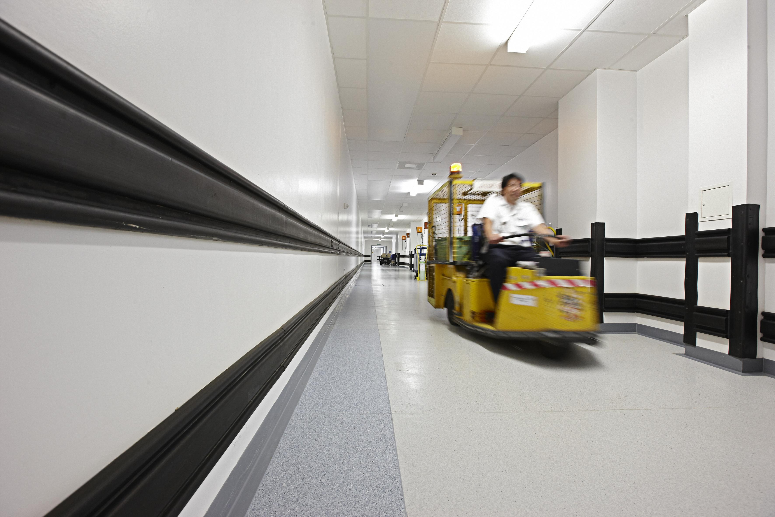
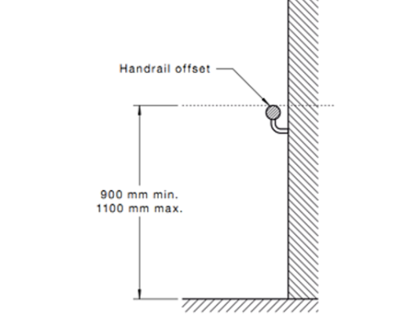
GUIDELINES TO INSTALL WALL PROTECTION
Follow manufacturer’s instruction
Consider different brick and drywall methods
Short walls and brackets
Spacing of brackets
Quantifying end caps and brackets
Correct adhesives

Slide 14
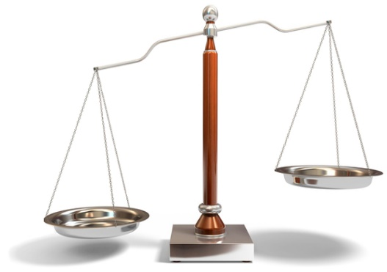
SO WHY GRADUS PVC-U OPTION OVER OTHER OPTIONS
PVC-u quality is extremely durable and hygienic – No chipping over time with an impact which could make other options open to high infection risk and aesthetically displeasing.
Has an embossed surface to hide scratches but the Gradus option not deep enough to harbor dirt – easy to clean
Wall guards have an inner PVC shock absorber during impact, meaning patients won’t feel the impact as much and wall protection lasts longer
Dry walls are used a lot in design and PVC wall guards can be installed on this surface with ease.
Vast colors and designs in various profiles that can match (Doors, walls, corners, behind beds, etc) making it aesthetically pleasing and great for wayfinding.
No rotting or possibility of vermin attack
Curve design makes it easy to keep clean, low maintenance, and modern looking
Not affected by possible water damage – so no shrinking or warping
Replaceable covers on certain profiles allow for easy and cost-effective replacement should it be needed
Choosing a neutral color means while there may be a need to change floors over time you won’t need to change wall protection.
PVC kickplates won’t dent with impact, looks amazing glued directly onto the surface with no need for screws that allow the unsightly build-up of dirt around screws over time.
4m lengths, as opposed to some 3m competitor products, mean fewer joints on long walls, and our unique
reveals make for a tight neat joint that detracts from the injection molded end caps.

Slide 15
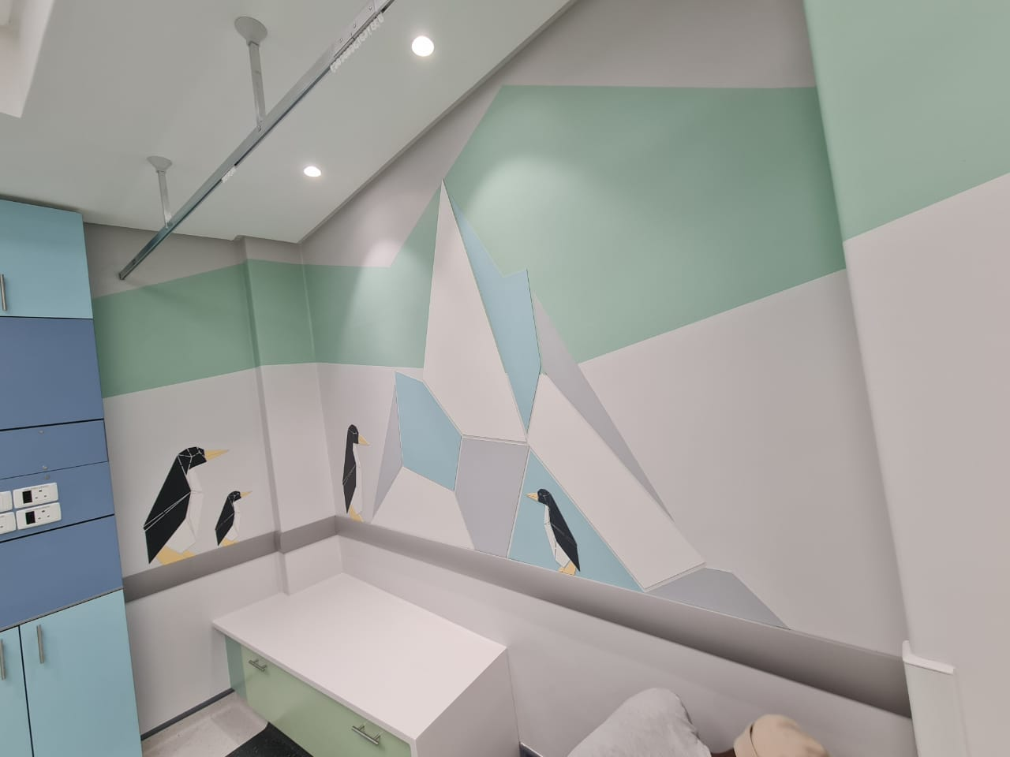
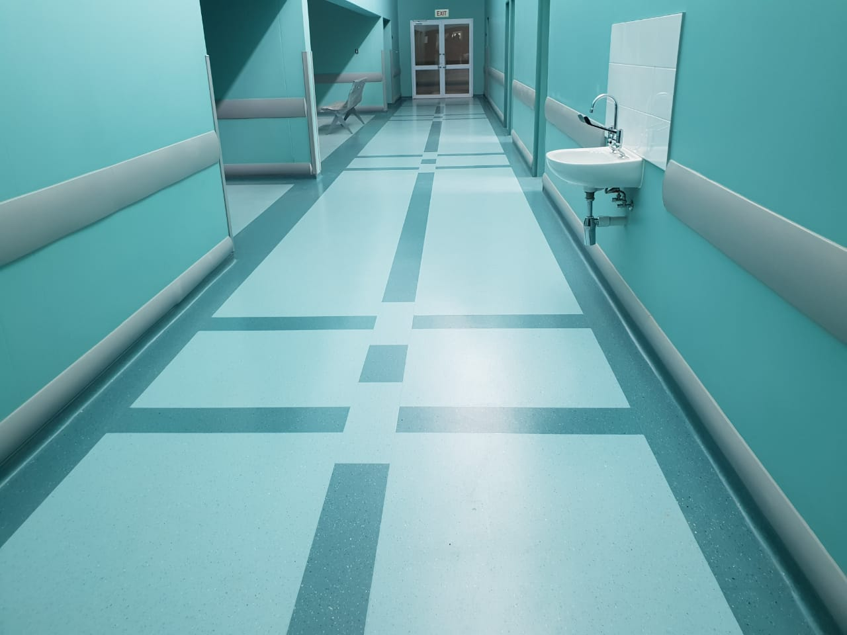
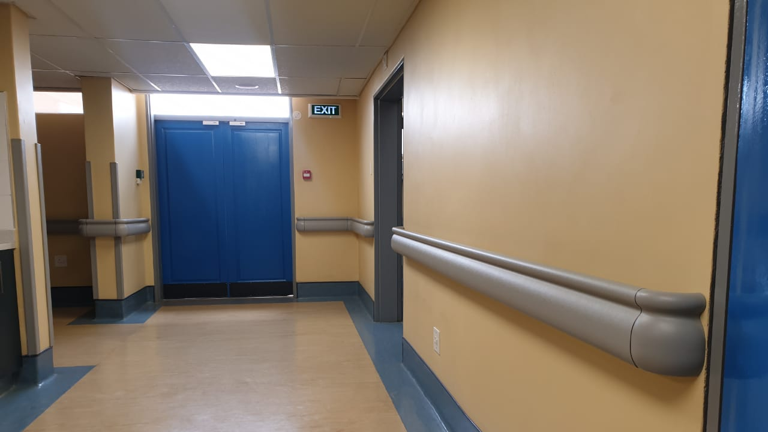
Gradus Wall Protection is unique, hygienic and great quality

Slide 16
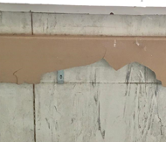
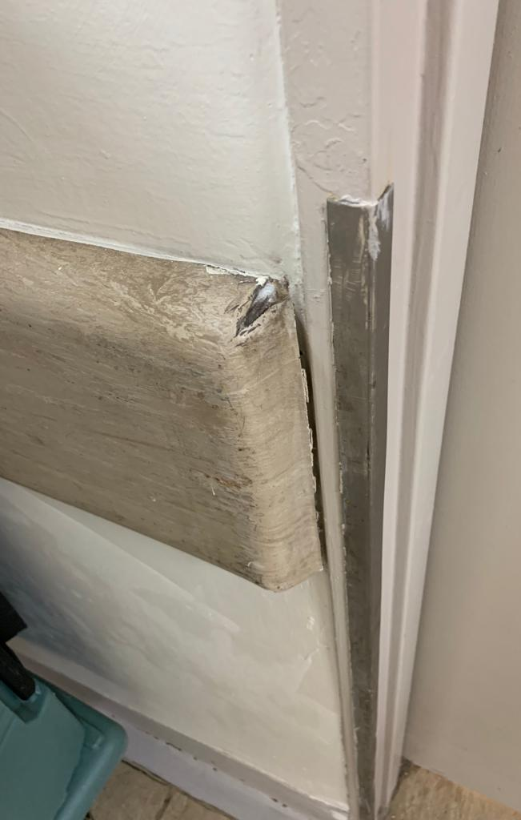
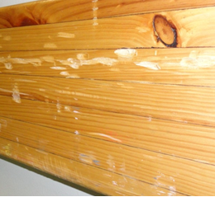
OBJECTIONS YOU MAY ENCOUNTER
1) TIMBER IS CHEAPER:
Over time timber does not wear well and aside from aesthetics the hygiene aspect is also compromised. What about other areas that may need corner guards, kick plates wall strips?
2) INTRAD IS MUCH CHEAPER:
There may be cheaper options however the benefits of our high-quality PVC wall guards are 2nd to none. (highlight the light embossing rather than deep lines making it easier to clean, internal shock absorber to handle greater impact without PVC cracking, replaceable covers, modern curvaceous design so dirt can’t easily settle on top making maintenance easier.
3) WE NORMALLY USE WOOD COVERED IN VINYL SHEETING:
PVC option is modern and more hygienic. Installation is a breeze and low maintenance long term as you don’t have to change the wall protection when you change flooring over time. Its ability to reverberate with impact makes it better when patients are being transported around. Again, cross-sell the corner guards, kick plates, bed head protectors, and wall strips, making for great aesthetics and wayfinding opportunities.
4) WE USE STAINLESS STEEL KICKPLATES:
Stainless steel can collect dirt around the screws and dent a lot over time making it unhygienic and aesthetically displeasing. Our PVC option doesn’t have these pitfalls.

Slide 17
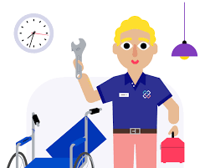
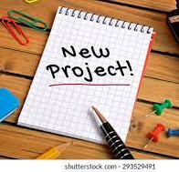
WALL PROTECTION GROWTH OPPORTUNITIES
THERE IS ESSENTIALLY ONLY TWO APPROACHES THAT WILL DEFINITELY HELP GROW WALL PROTECTION SALES IN HEALTHCARE:
Having a wall protection deal for every healthcare deal opened. Should it not be required or other options are used at least we start building that relevant data on Hubspot. Remember even if they insist on wood or wood covered in vinyl the opportunities for sure protect endure on doors and behind beds or corner guards or rubber in service areas are still up for grabs!
Maintenance work!!! Sometimes just a walk-through with a maintenance manager will earn us some much-needed sales. They forget we have wall protection when they discuss vinyl flooring so remind them. Send regular emails with pics.
NB. Remember changing a spec later is much harder so, get the spec in before the BOQ goes OTT.

Slide 18
HEAD OFFICE SUPPORT FOR GROWTH IN HEALTHCARE
Independent laboratory tests for hygiene and performance is being investigated
Stock levels are steadily being increased to meet the demand, quotes, deliveries, and assistance with the opening of accounts will be done timeously.
Sandy and I will be on hand for both specification presentations/meetings, technical assistance on or offsite, working on plans with the client to assist on the most cost-effective solutions to meet all areas of need.
Our leads Generation team will be adding wall protection healthcare deals onto HubSpot for you.
Marketing department will be running a series of supporting blogs as well as new innovative approaches to drive interest.
Any challenges experienced with the quality or performance of our products will be dealt with as quickly as possible with assistance from the UK where necessary.
Where possible, new local supporting products (like the rubber) or components (like our aluminum brackets) will be developed where the need and the demand increase.
Knowledge Base updated regularly

Slide 19
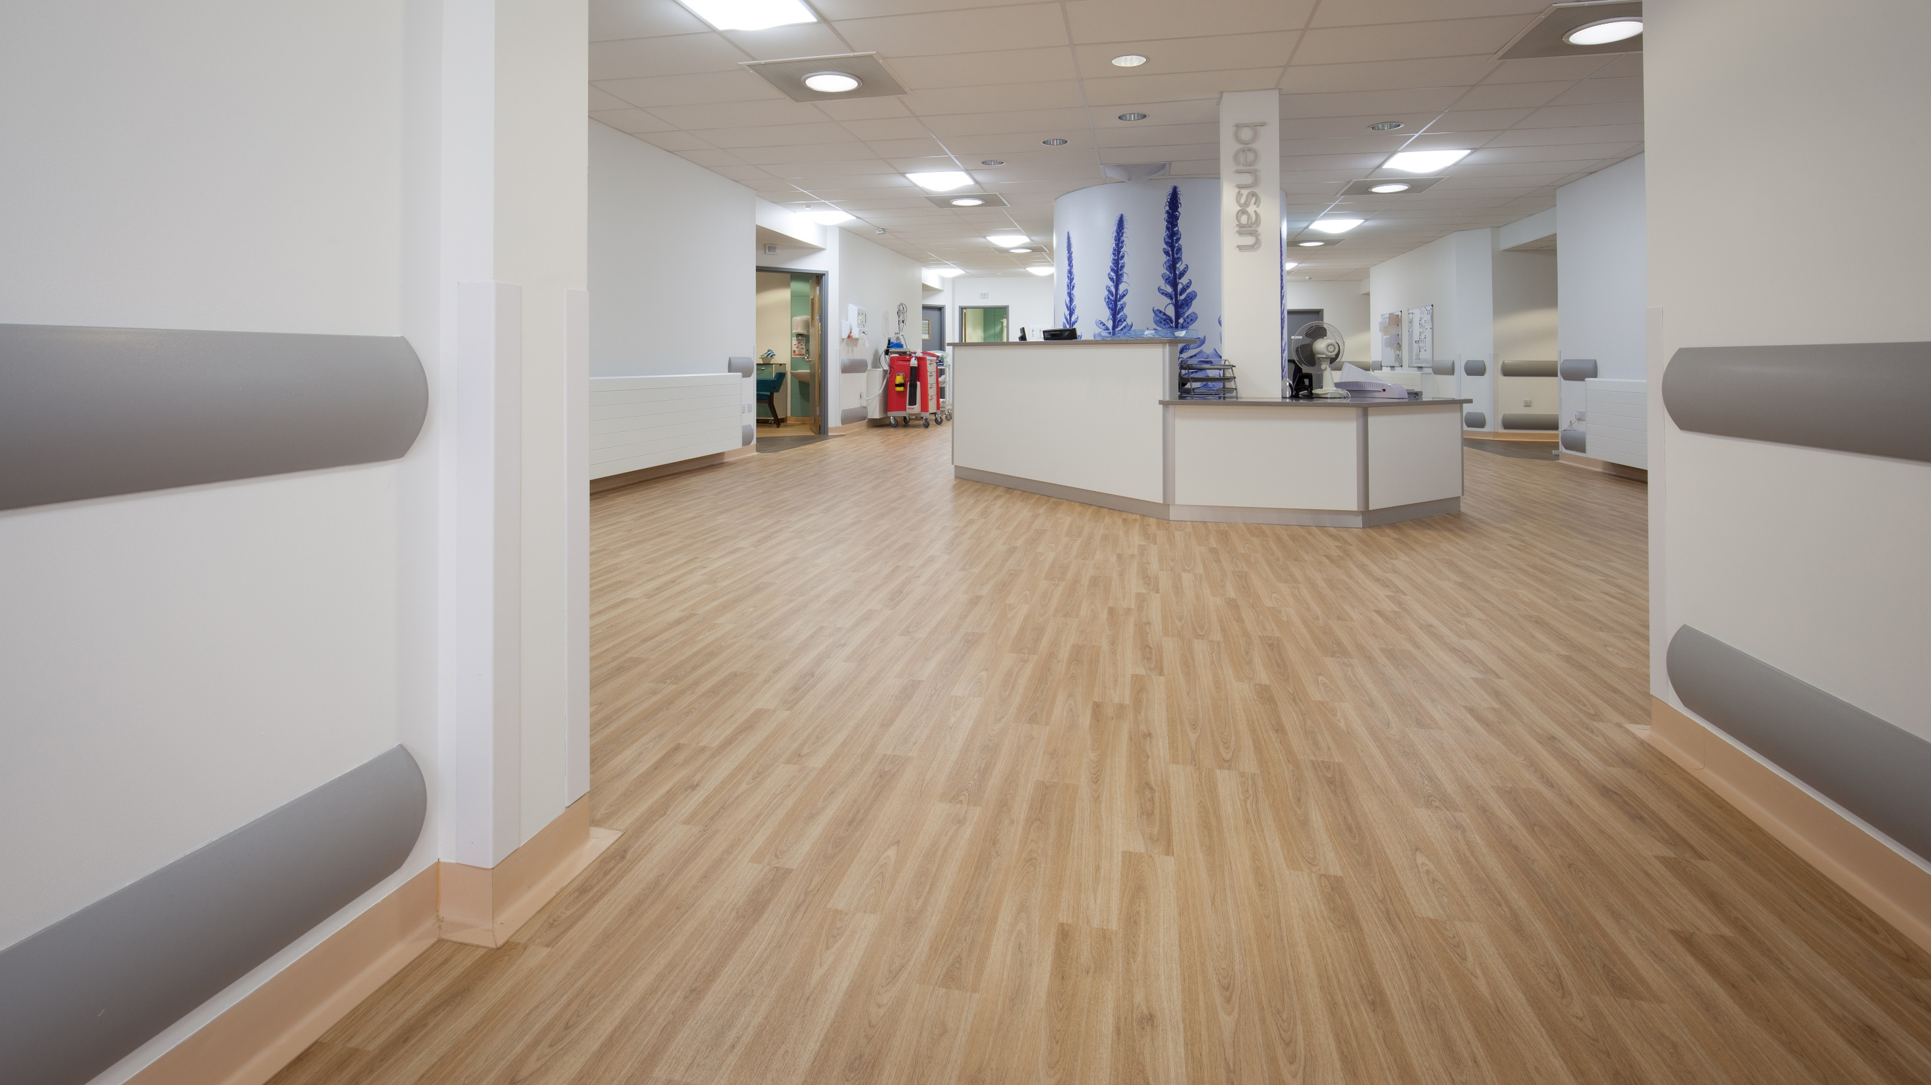
Notes:
An example of how wall protection blends into modernised spaces and compliments any design scheme
Profiles are measured for Light reflective values to assist disabled and visually impaired patients
Neutral colours can allow to play with wall and floor colours too!

Slide 20
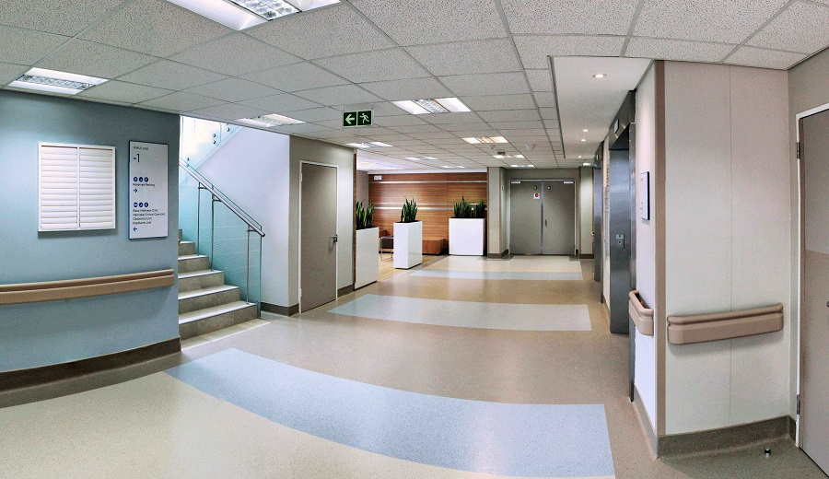
PVC-u COMBI RAILS - A HANDRAIL AND WALL GUARD IN ONE PROFILE

Slide 21
Notes:
GVT PROJECT: Bethal Hospital in Mpumalanga.
Curvaceous design allows for low maintenance

Slide 22
Wall Protection – Beautiful and functional
Notes:
Endure sheets (also used as kick plates) can be used on wall as décor and functionally protect walls from damage at the same time.

Slide 23
Notes:
We believe in giving back and have contributed to countless CSR projects, with a long relationship with the Carte Blanche Making a Difference Trust and Surgeons for Little Lives which have made untold differences to people lives.
Kimberley BPH Billiton Paediatric Intensive Card Ware
Chris Hani Baragwanath Neonatal Operating Theatre
Paediatric ICU and High Care Ware Charlotte Maxeke Academic Hospital
Paediatric Theatre Upgrade Frere Hospital
King Edward VIII Paediatric Centre of Excellence
Infant High Care Unit - Sebokeng Hospital
Tygerberg Paediatric Theatres
Ngwelezana Hospital (KZN) Paediatric Unit Project
Surgeons for Little Lives
Chris Hani Baragwanath Paediatric Surgical Admissions, out patients and sleep over unit
South African Breastmilk Reserve
SPCA Nelspruit Operating Theatre
Community Scout Hall
Community Police Station

Slide 24
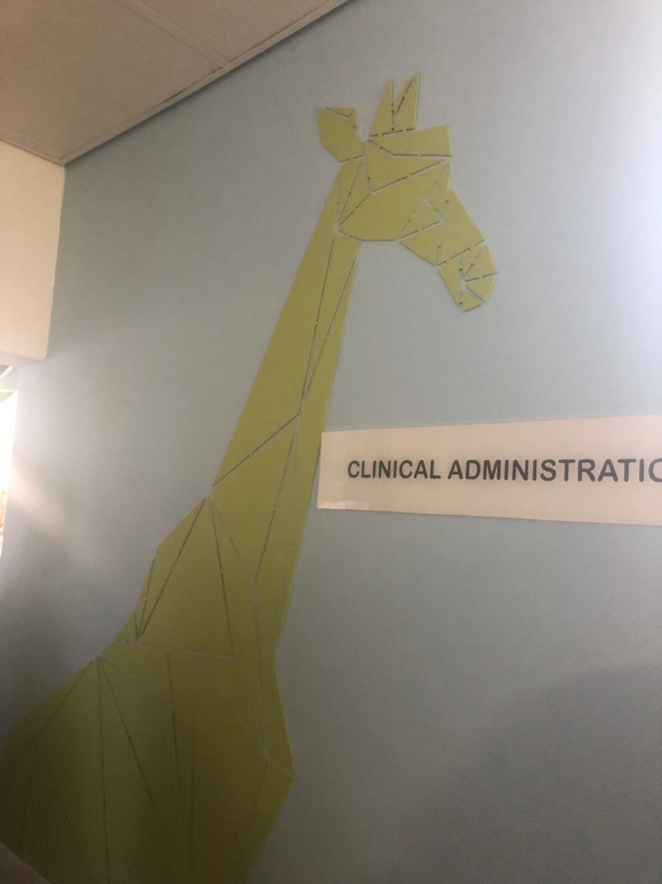
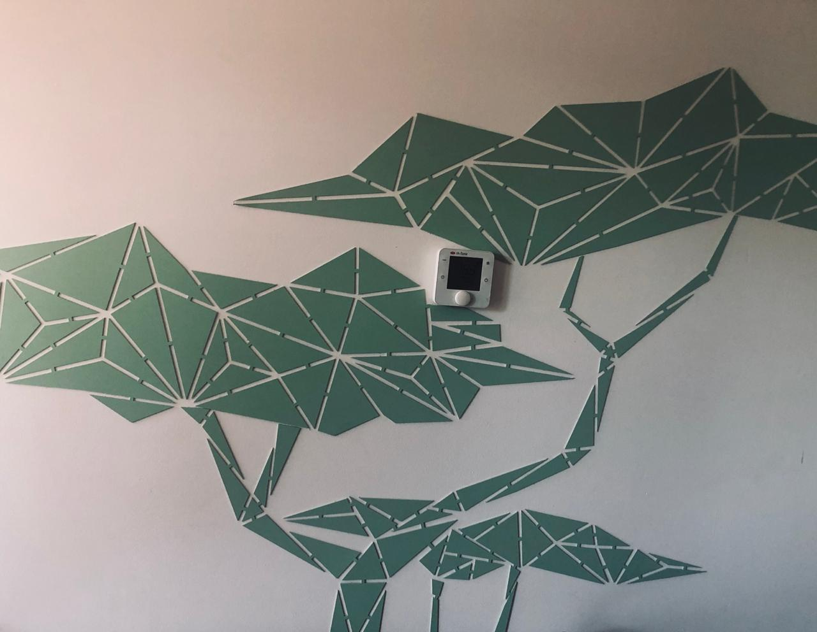
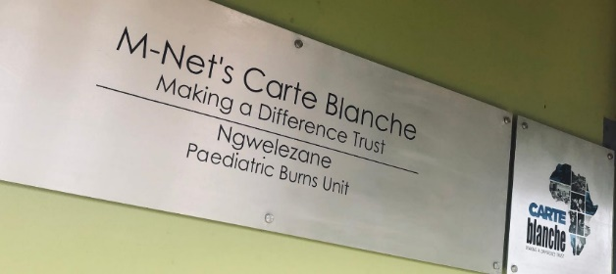
Notes:
SURE PROTECT ENDURE
Ngwelezana Paediatric Burns Unit in KZN
Waterjet cut locally
possibilities to improve aesthetics and still protect the interior building

Slide 25
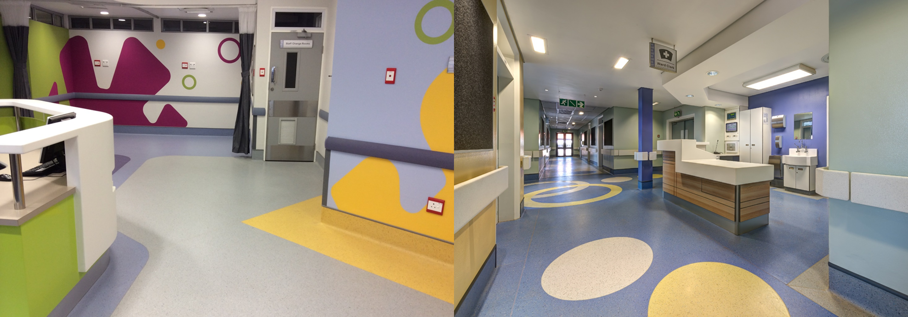
Frere Hospital (Carte Blanche Making a Difference Trust)
Notes:
Use of colour and design can make such a difference in healing and wellbeing of both staff and patients

Slide 26
THANK YOU FOR YOUR TIME!
Subscribe to our blog
for valuable insights and advice
from our team of experts
http://info.polyflor.co.za/news

