Slide 1
SHOPFITTERS TRAINING
Notes:
Expand into new industries and grow relationships – Getting involved with exhibitions stands and exhibition and conference centres
Identify new products and opportunities – Could be a product or a service

Slide 2
What is a shopfitter
Shopfitting is the business of fitting out commercial premises with equipment, fixtures and fittings. This can be anything from retail, commercial buildings, hospitality and healthcare projects.
NB : No education projects observed however I have come across shopfitters involved in private education projects.

Slide 3
What does a shopfitter do ?
A shopfitter executes planning according to budget by designing the shop layout and installing various equipment and services.
This business is aimed at new buildings or an existing building that is doing renovations.
Shopfitters often have interior designers in their business doing the design and layout.

Slide 4
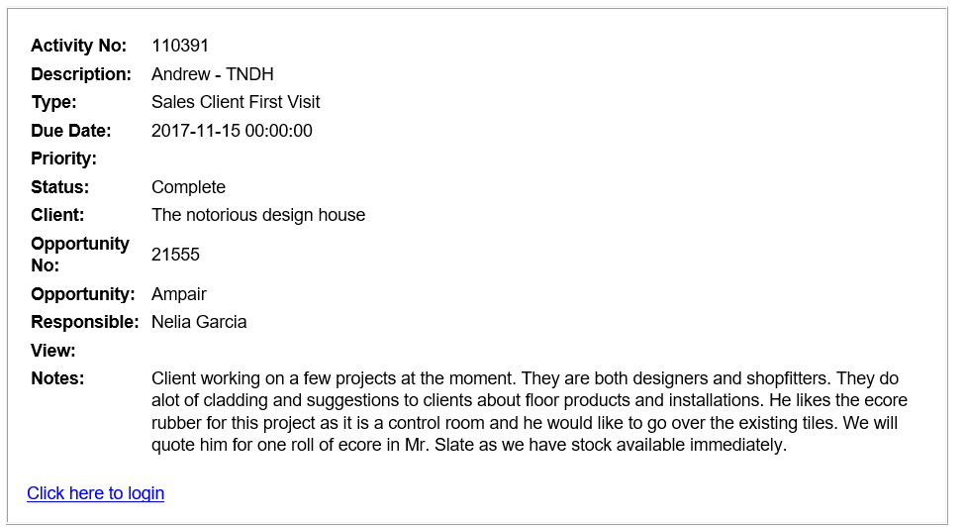
Case study

Slide 5
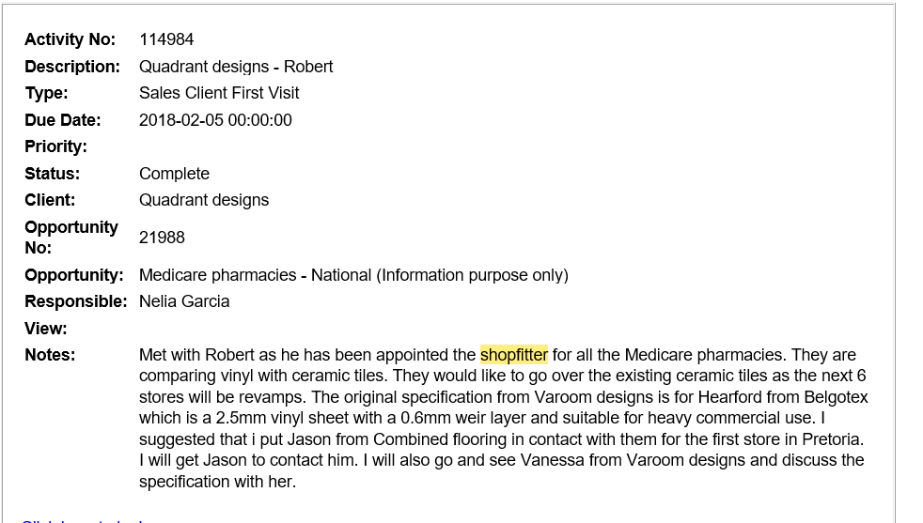

Slide 6
Pan Africa Shopfitters

Slide 7
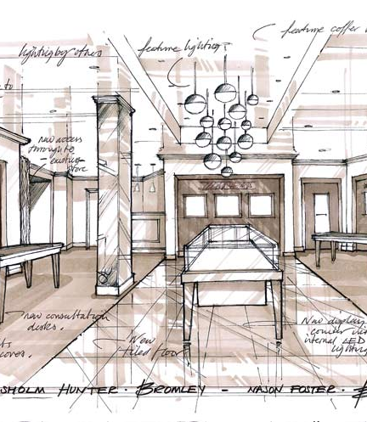
Expertise
Shopfitting is a variety of trades put together under one umbrella, it entails various disciplines and would often need to assemble a team or outsource some of the work depending on the skill set
Services include :
Interior design
Signage
Fittings
Other equipment and services

Slide 8
The shopfitting process
The job assessment begins with a survey and measurements of available space, an interior designer will prepare drawings to be approved by the client. Once the plan is approved the shopfitter arranges to purchase the various materials and equipment needed, manufactures and installs them.
What does a typical shop entail :
Counter (endure sheeting)
Shelving
Signage
Lighting
Floor and ceiling

Slide 9
Our objective
Expand into new industries and grow relationships with influencers
Grow Gradus business
Grow PolyFlor customer base
Identifying new products and opportunities
GTFO !!!!!!

Slide 10
Plan of action
Phone
Appointment
Needs analysis
Proposal

Slide 11
How do we deal with this client
Sell directly to Shopfitters
Train their teams to do the installation
Use their relationships with corporates or end clients to market our product
Develop back up documentation and tool kits based on initial research and needs analysis

Slide 12
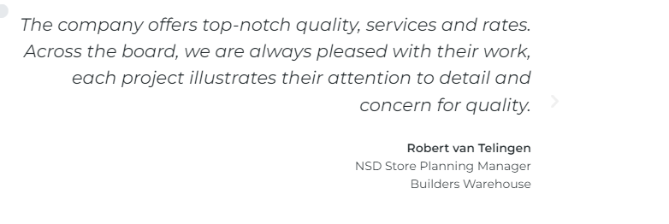
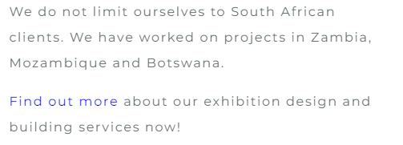
Providing shopfitters with wall protection
Providing flooring products to shopfitters
Identify new opportunities for Polysales SA & Africa (products etc)
Use their relationships to grow our business
Grow into Africa
Shopfitters builds expo stands – Polyflor loose lay products
Improve “day to day” business (quick wins)

Slide 13
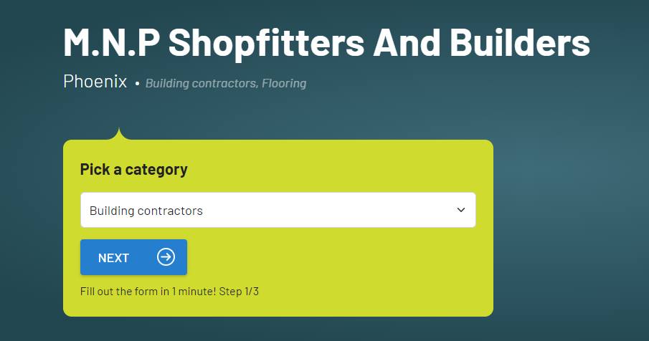

Slide 14
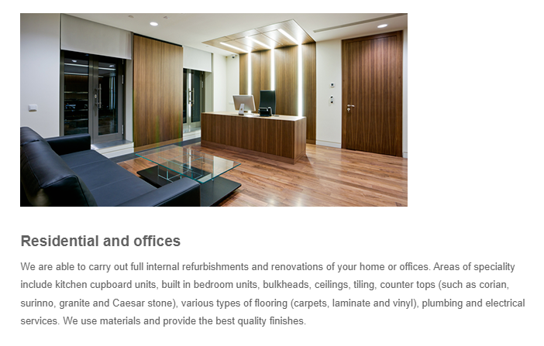

Slide 16
Case studies
Notes:
Titan Shopfitters – Ster Kinekor
Shopfitting concepts – Sorbet account

